Slide 1
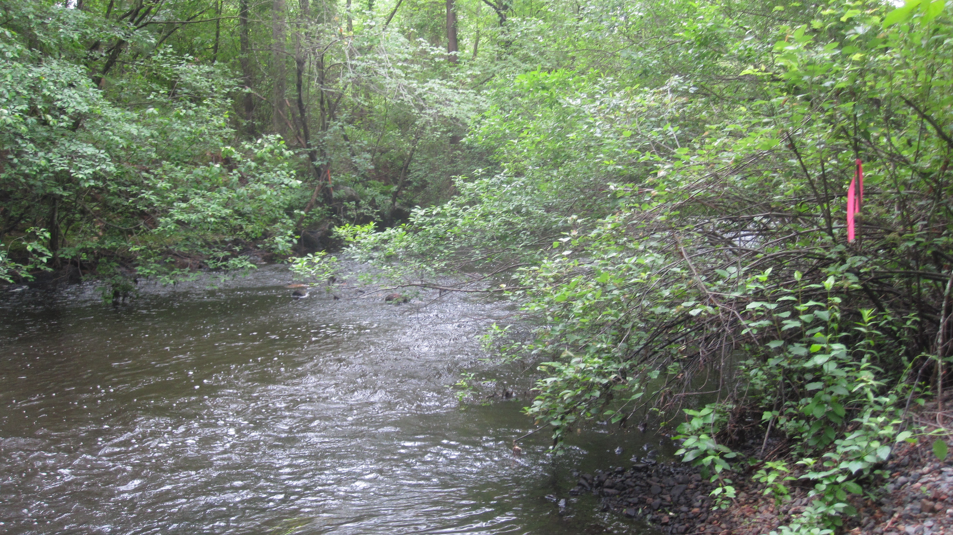


Scaling river network aquatic function through space and time
Wilfred Wollheim
University of New Hampshire
PNNL - River Corridor Monthly Meeting
Jan 17, 2023
E-mail: wil.wollheim@unh.edu
Twitter: @WilWollheim
Notes:
ABOUT AQUATIC FUNCTION. Role of streams and rivers in
First half of talk will be about some potential theories, approaches for generalization of function
Second half about sensor networks. What kind of network is needed to identify the role of aquatic function

Slide 2
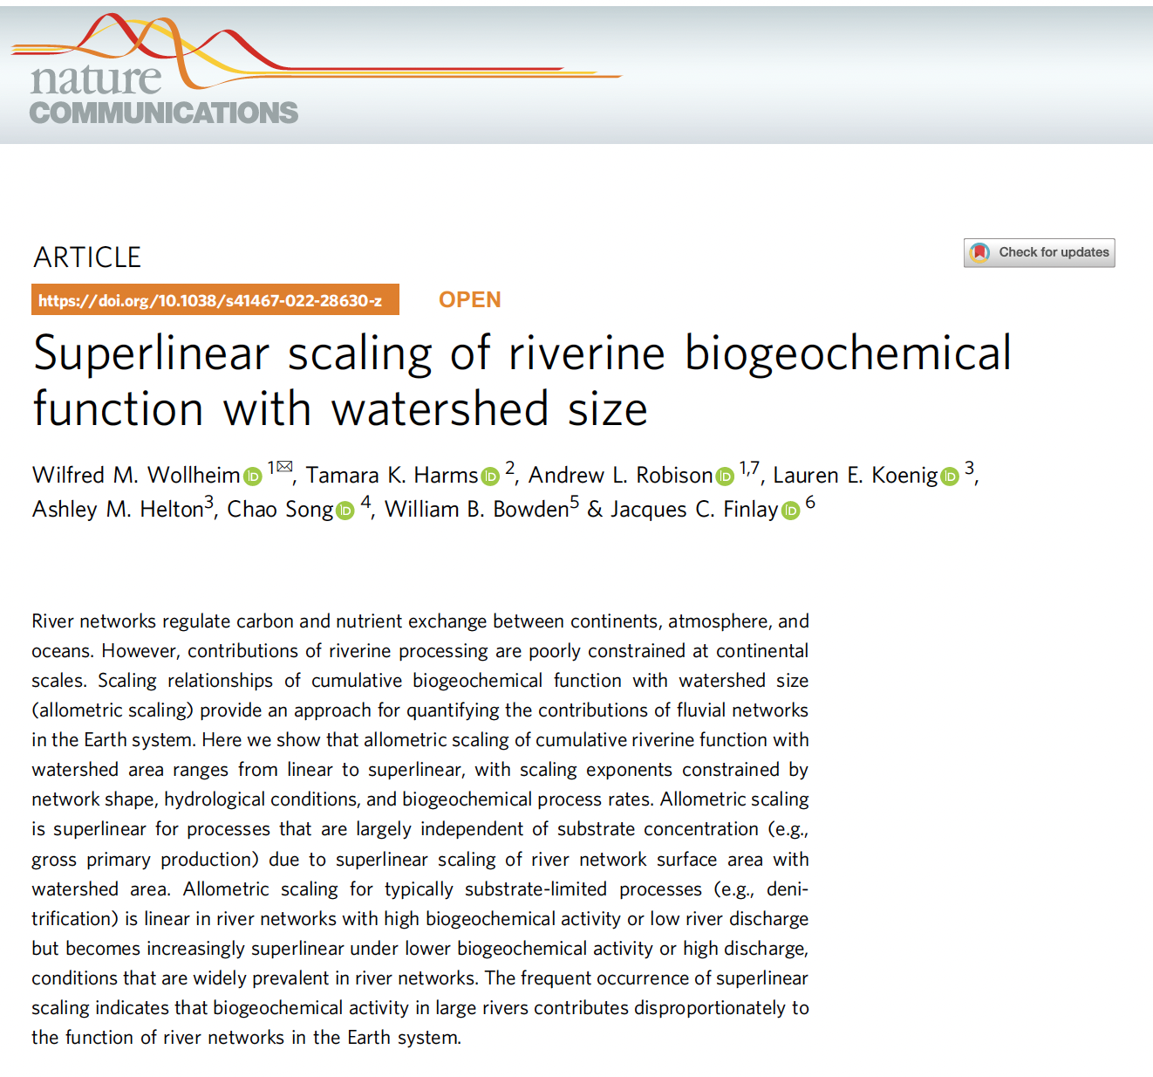
Funded by NSF Macrosystems Biology

Slide 3
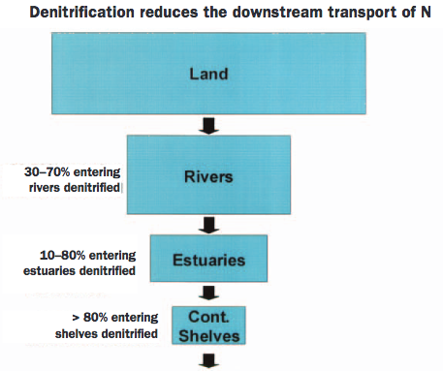
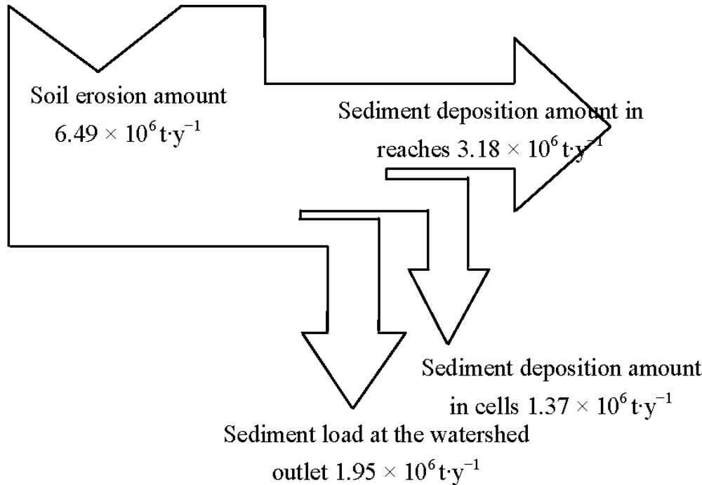
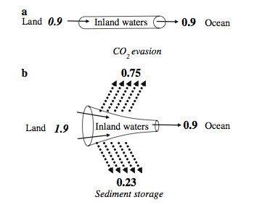
Freshwaters influence downstream flux of material inputs from land
Nitrogen (Galloway et al. 2003)
Sediments (Hua et al. 2012)
Carbon (Cole et al. 2007)
Notes:
Aquatic systems are hypothesized to be important transformers of a number of biogeochemical constituents.
Changes in N, Terrestrial Carbon, sediment
Usually this function only emerges at broad spatial scales –need to think about networks.

Slide 4
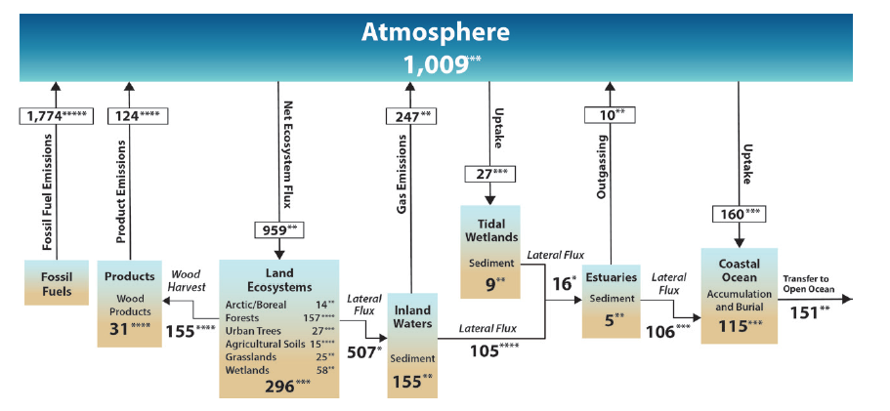
North American Carbon Cycle
Hayes et al. 2018. Ch. 2 North American Carbon Budget. In Second State of the Carbon Cycle Report.
Notes:
Second State of the CC just released
Net ecosystem exchange on land = 959
Lateral flux = > 50% of this. Half of this is then evaded (either from direct pCO2 or OM respiration)
Fluvial networks (including streams, rivers, lakes, etc) are clearly important!

Slide 5
What Kind of Scaling for River Network Function?
Cumulative function over all streams/rivers (ponded waters) in entire network
NO3 loss (assimilation or denitrification), DOC oxidation, gas evasion, sediment deposition, pathogen mortality, etc.
Space – increasing watershed area
Time – accounting for flow variability
Notes:
ALSO ponded waters
All functions there in theory could be measured with sensors.

Slide 6
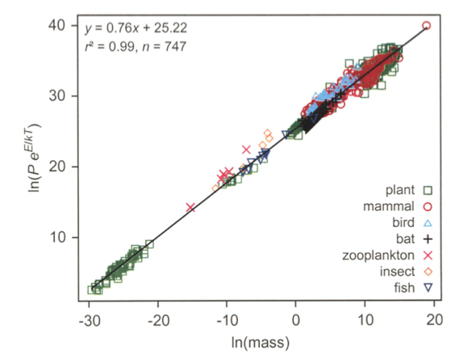

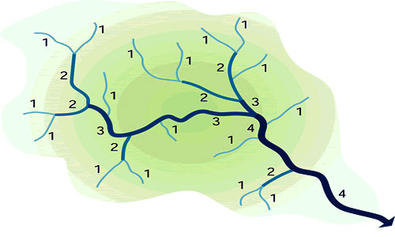

Space: Inspired by Metabolic Theory of Ecology
F = c A^{d}
?
ln(F_{network})
c
1 km²
Watershed area
Brown et al. 2004
Notes:
The slope (log-log scale) is 0.75. What about watershed area and metabolism

Slide 7
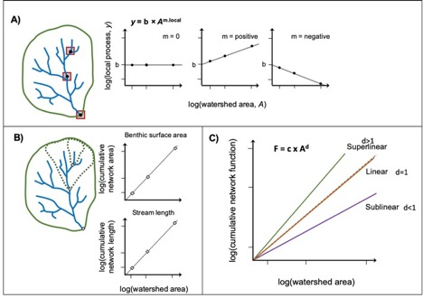
Space: Allometric Scaling of Cumulative Aquatic Function vs. Drainage Area
LOCAL
Process Rate Scaling
CUMULATIVE
Process Scaling
Notes:
Key point: need to consider large watershed scale

Slide 8
The fractal basis: Metabolic networks vs. River networks

Slide 9
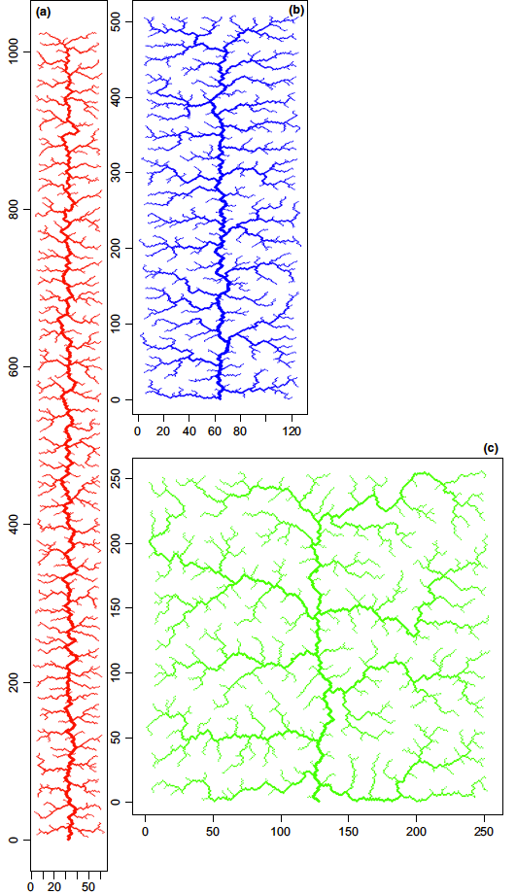
Integration of Geomorphology, Hydrology, and Biology
width=aQ^{b}
Helton et al. (2017)

Slide 10
Cumulative Length Scales Linearly. Cumulative Surface Area Scales Superlinearly.
Power Slope = 1
Benthic surface area always increases super linearly
Power Slope
1.11 – 1.41
Notes:
Constants are normalized to compare slopes

Slide 11
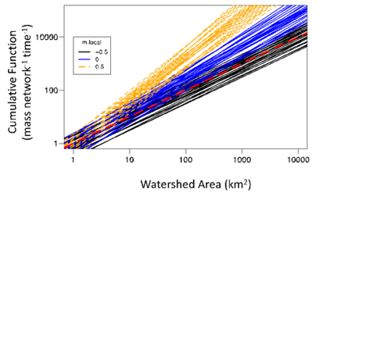
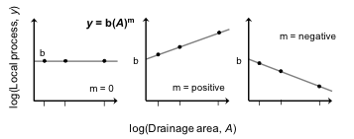
Function tends to scale superlinearly (Zero-order processes like GPP or ER)
Power Slopes ->
1.53 – 1.87
Cumulative function always linear to super linear
Biological activity scaling has greater influence than geomorphology or hydraulics on slopes
Power Slopes ->
0.95 – 1.09
Biological Activity Slope
0.5 (increasing with river size)
0 (constant)
-0.5 (decreasing)
Notes:
We can look at different scenarions of how biology changes with river size. Does it increase with stream size (e.g GPP), does it decrease with stream size (e.g. ER if OM inputs are upstream), or does it remain constant?
Blue, then Green, then Red.

Slide 12
Real World Application How does carbon produced by entire river network scale with D.A.?
Observed Local Gross Primary Production (GPP) vs. River Size (as characterized by D.A.)
Observed Local Ecosystem Respiration (ER) vs. River Size
Finlay 2010
Notes:
NOT NESTED!!!!!
LOCAL Scaling (Not Cumulative). Earlier scenario of increasing
Power slope of 0.49 for GPP, 0.25 for ER.

Slide 13
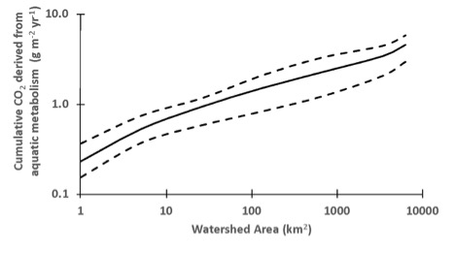
Cumulative aquatic carbon production is superlinear (rectangular network, mean r.o. = 500mm yr⁻¹ )
4.7 gC m⁻² yr⁻¹
COMPARISON WITH LITERATURE
Total aquatic CO₂ emissions = 24 gC m⁻² yr⁻¹ (Butman et al. 2018)
Aquatic Metabolism Contribution to C emissions = 28%. (Hotchkiss et al. 2015)
Aquatic metabolism CO2 emissions = 24 * 0.28 = 6.7 gC m⁻² yr⁻¹
Aquatic (ER –GPP) per unit watershed area
Notes:
Headwater catchments contribute little. Despite having higher per unit area NEP, because not enough benthic surface area. Steepest increase is towards intermediate watersheds. Slow increase in larger rivers because NEP per area declines as GPP increases faster with river size than

Slide 14
More realistic model: concentration-dependent (1st order) processes
Representative of most biogeochemical processes across interfaces
Nutrient uptake
Denitrification
Gas exchange
Particle settling
Uptake velocity (υ_{f})
AREAL UPTAKE / CONCENTRATION
Allows nutrient concentration to limit function, especially downstream
Upstream removal proportions depend on flow, accounts for flow impacts.

Slide 15
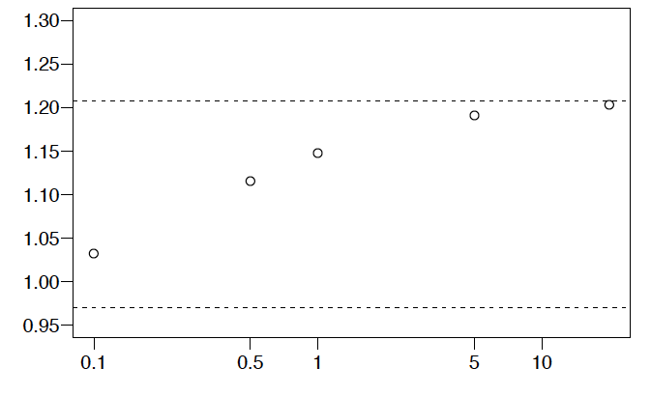
As flow increases, allometric scaling shifts from linear (loading scaling), to super linear (reactive area scaling).
Cumulative Benthic Area vs. DA slope
Network Scale Cumulative
Process Slope
Cumulative Length vs. DA slope
Runoff (proportion of mean annual)

Slide 16
Model Can Be Used to Understand Scaling for Different Processes
Data from:
Ulseth et al. 2019
Ensign and Doyle 2005
Mulholland et al. 2009
Mineau et al. 2016
Georgian et al. 2003
Wollheim et al. 2001

Slide 17
As reaction rate (vf) declines, scaling becomes superlinear: for same reason as with flow.

Slide 18
Implications
Nitrate uptake vs. Denitrification vs. Degassing of terrestrial CO2
When superlinear, watershed size matters for global cycles (large rivers contribute disproportionately
Gas evasion, NH4 assimilation
Nitrate Assimilation
Denitrification

Slide 19
Opportunities
Relative importance of HTS
Role of heterogeneity
Role of anthropogenic activity
Nested sensor networks will improve testing of model results.
Deploy in multiple watershed types to generalize
Accurately capture loading (small headwater streams)
Conservative vs. reactive solutes
Account for storm events, flow variability

Slide 20
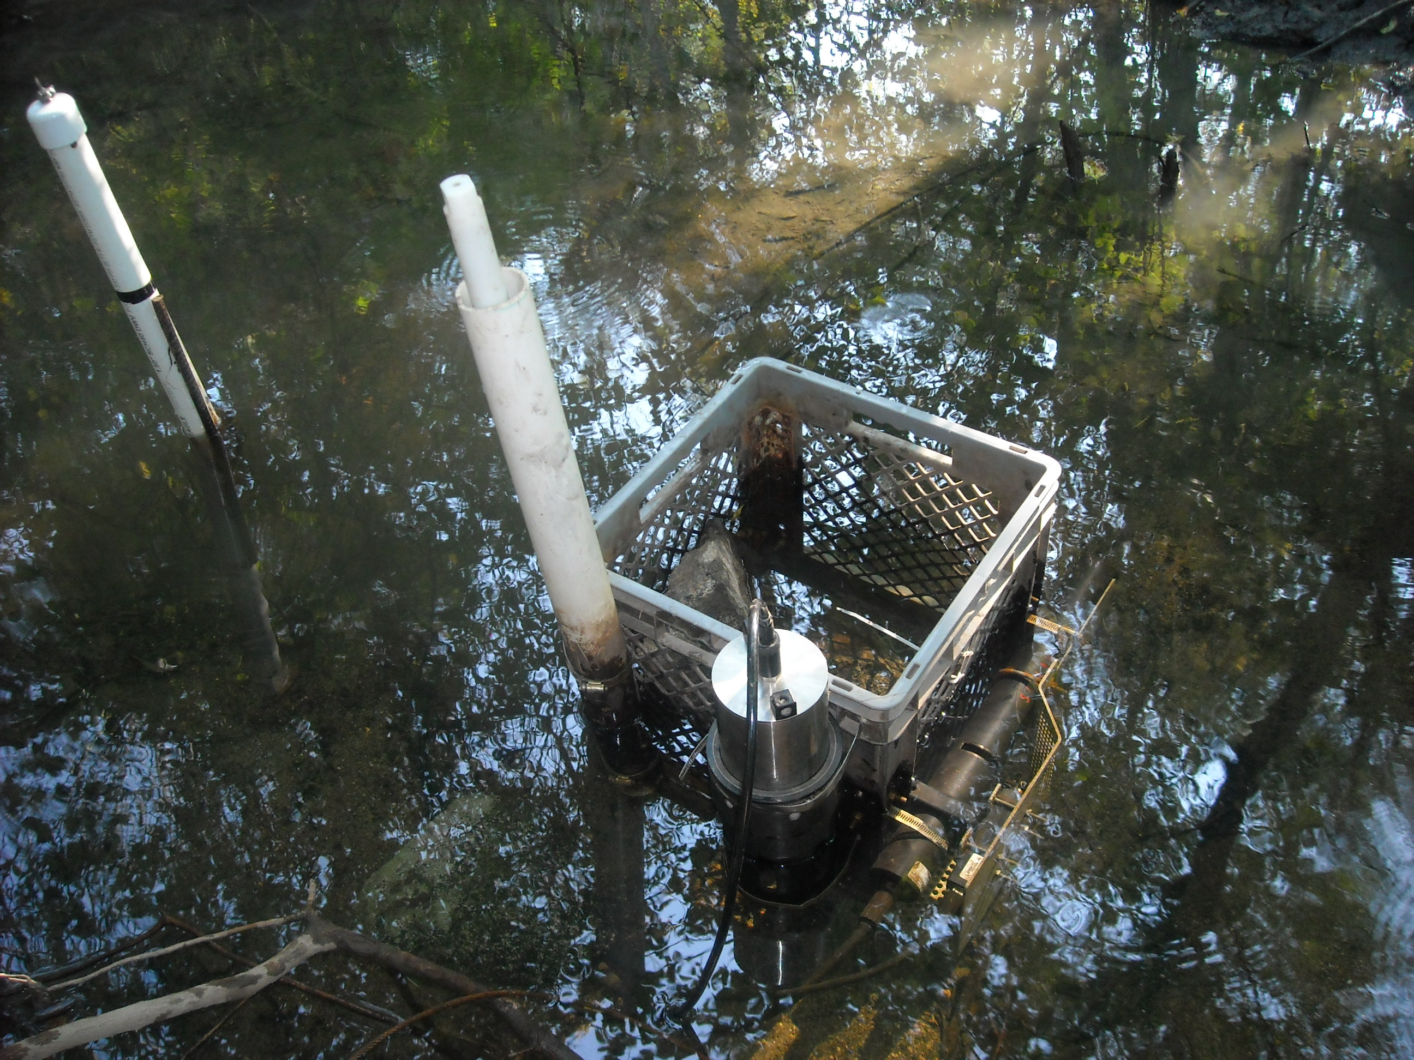
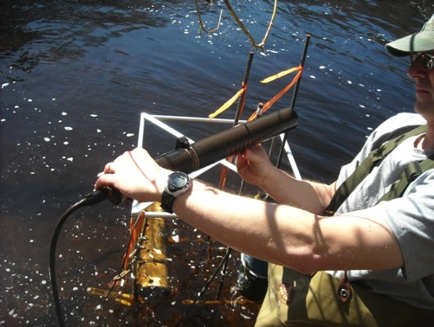
Design of sensor networks for river network scale function
Nested within single network
What comes in (inputs)
What goes out (patterns)
Plus
Synoptic measurements (patterns)
Spatially distributed process rates (transformations)
Include Both: Reactive and conservative tracers

Slide 21
Nested Sensor Network
Forest Ref
Anthro 1
Anthro 3
NO3
Flux
Cl
Basin Mouth
Storm Size
Anthro 2
Wollheim et al. (2017)
Notes:
Depicted graphically here.

Slide 22
Dynamic River Network Model Predictions Within Empirical Error
River Network Model Prediction
Data from Wollheim et al. 2017. WRR.
Model based on Wollheim et al. (2006, 2018). Includes only net removal.
Notes:
When we apply a simple river network model, using parameters based on literature for denitrification, we get this pattern.
Shows similar response to increasing flow. High retention for small storms, declining, but never cross zero, because this simple model only includes net retetnion, not resuspension

Slide 23
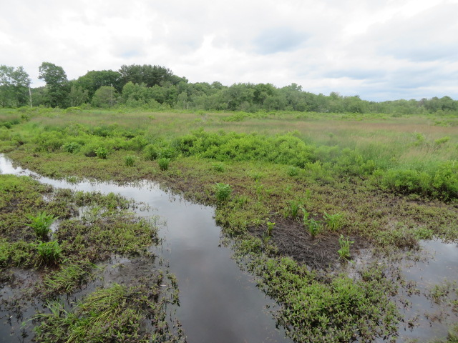
Thank You!
E-mail: wil.wollheim@unh.edu
Twitter: @WilWollheim

Slide 24
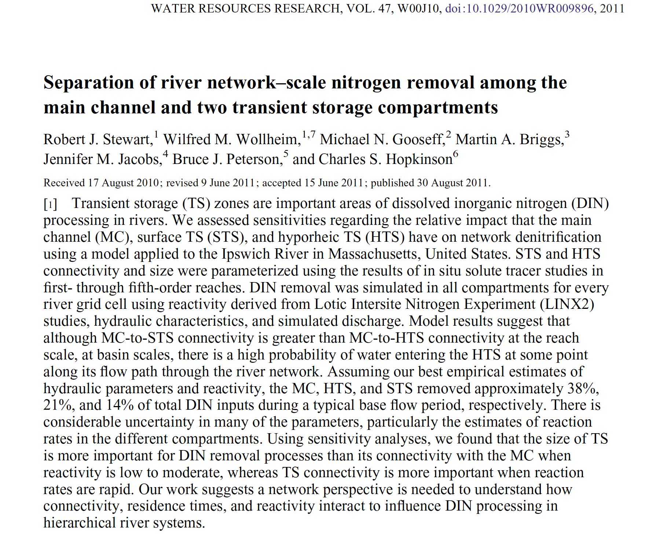

Slide 25
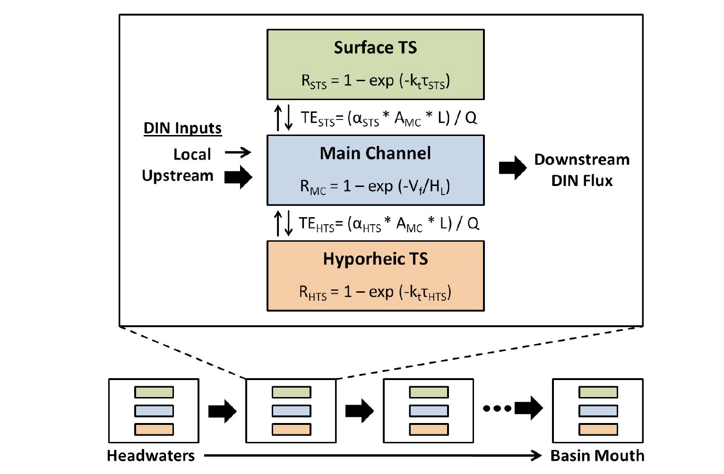

Slide 26
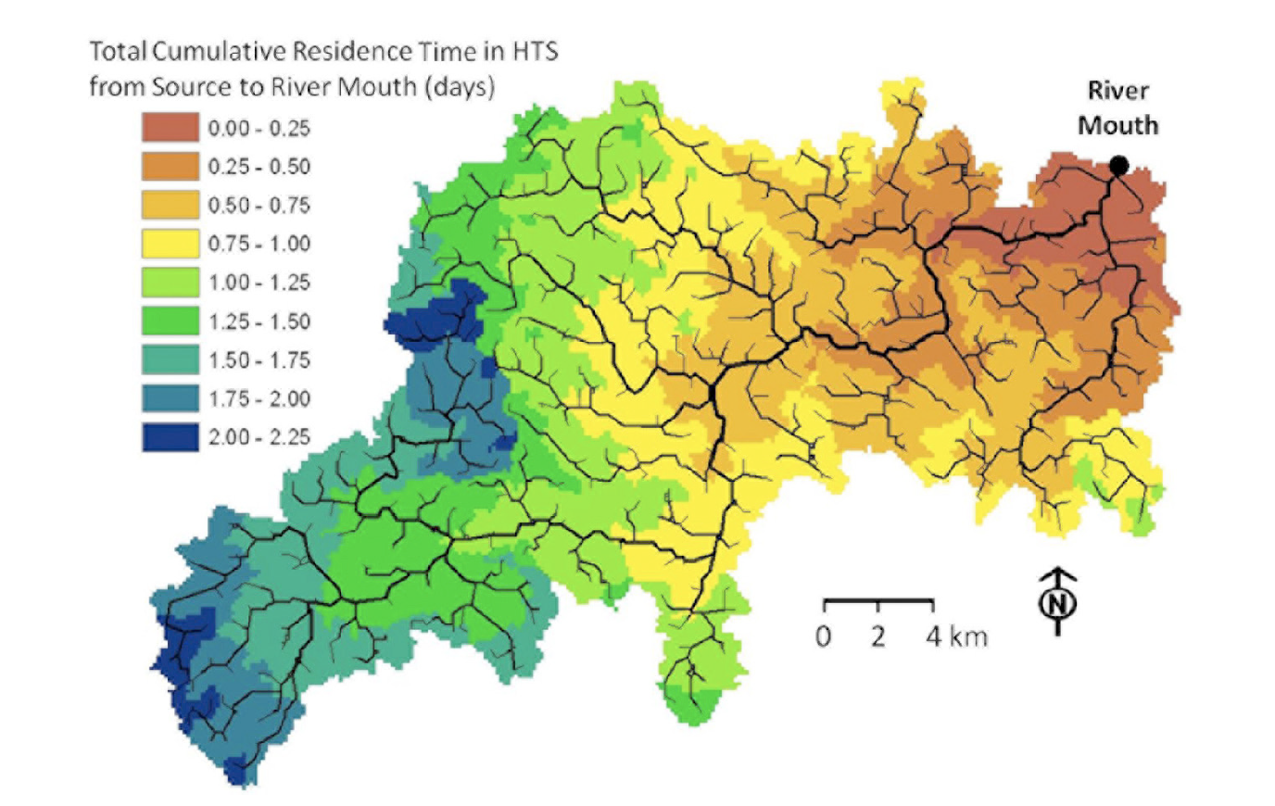
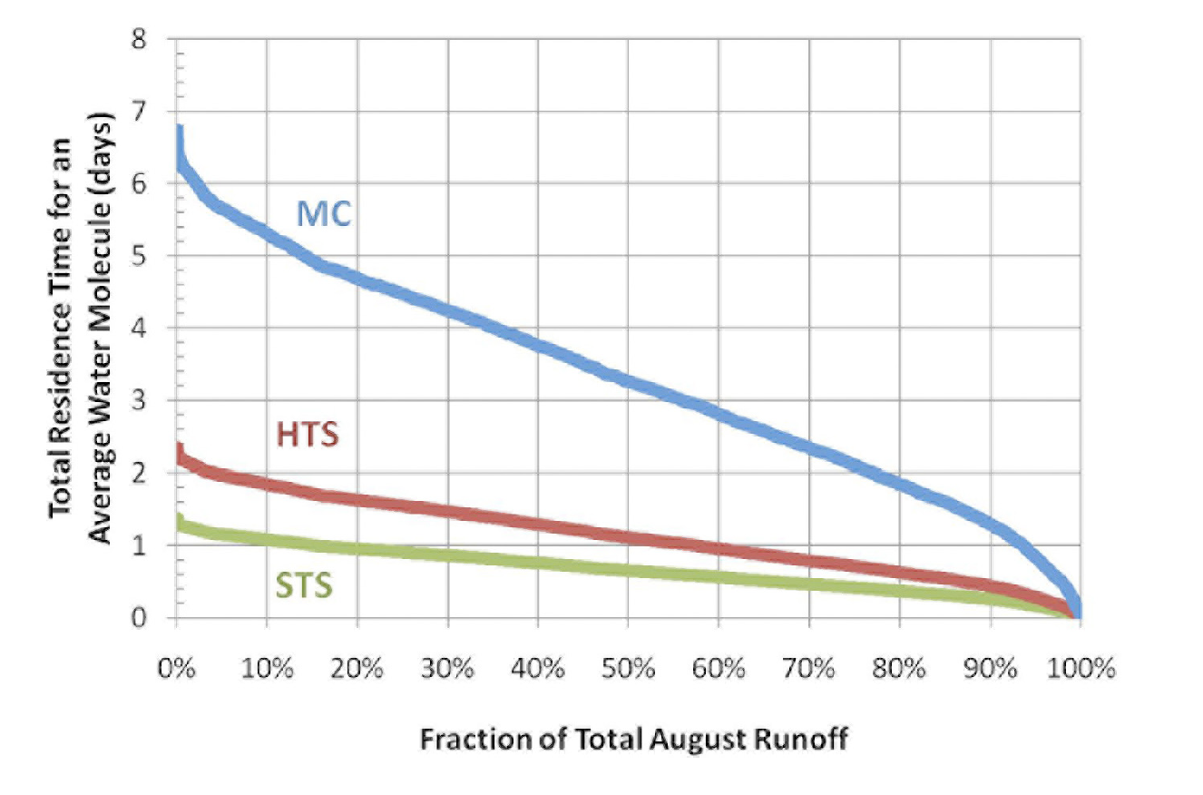

Slide 27
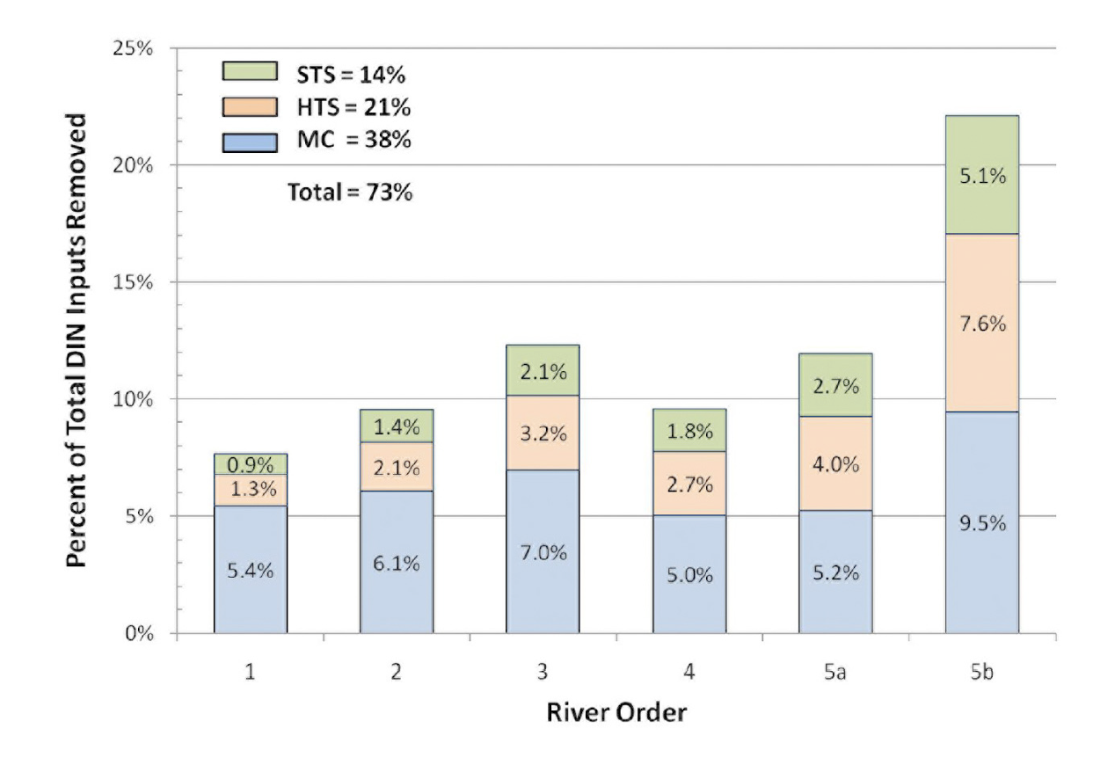

Slide 28
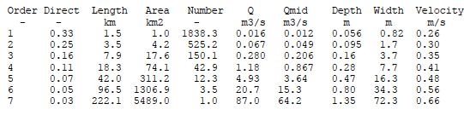
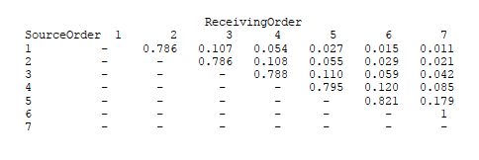
Statistical Model (Wollheim et al. 2006, 2018)

Slide 29
Assumptions
Spatially uniform runoff (500 mm yr⁻¹) and loading concentration
Distribution of loading does not change with increasing runoff
Chemostatic
Homogeneity (except gradients with river size)
Linear uptake kinetics
A variety of river network shapes and hydraulic assumptions of width vs. Q
ESTIMATE CUMULATIVE UPSTREAM BIOGEOCHEMICAL FUNCTION WITH INCREASING WATERSHED SIZE

Slide 30
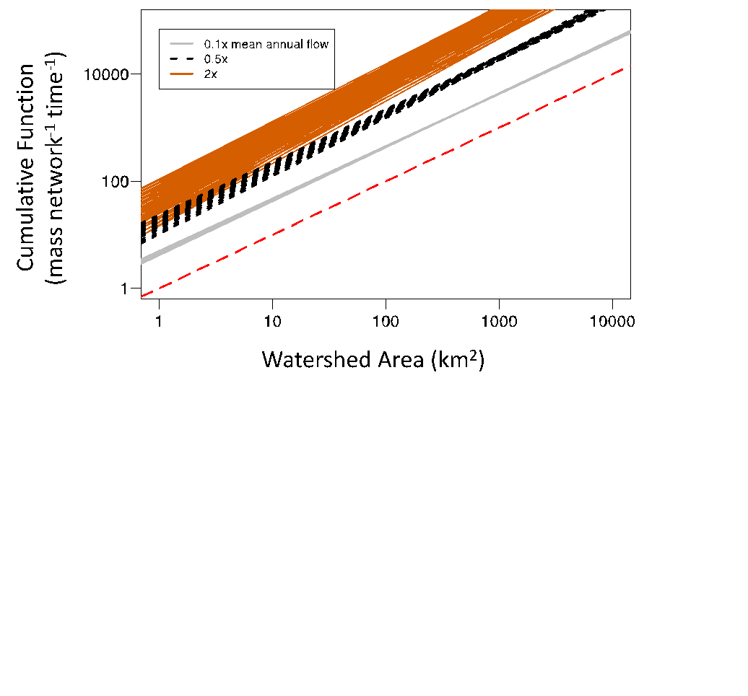
Flow affects allometric scaling: Low flow = linear, high flow = superlinear
High Runoff = 2500 mm/yr
Power Slope ->
1.07 – 1.33
Low flow has linear scaling
Approaches cumulative length scaling
High flow shifts to super-linear scaling
Approaches cumulative benthic area scaling
Low Runoff = 50 mm/yr
Power Slopes ->
0.98 – 1.12
Notes:
Vf = 100 m/yr
At low flow, slopes are nearly linear (approaching length scaling)
At high flow, slopes are superlinear (near BSA scaling

Slide 31
As flow increases, allometric scaling shifts from linear (loading scaling), to super linear (reactive area scaling).
Cumulative Benthic Area vs. DA slope
Network Scale Cumulative
Process Slope
Cumulative Length vs. DA slope
Runoff (proportion of mean annual)

Slide 32
Why does scaling parameter shift from linear to super linear when flow increases?
Distribution of Loading (constant)
RELATIVE TO
Distribution of Processes (Source Limitation)

Slide 33
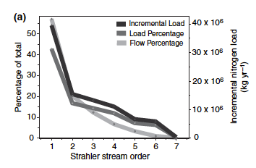
MOST INPUTS TO HEADWATER STREAM:
Distribution of River Inputs to Entire River Networks
Direct Inputs
Stream #’s
Wollheim et al. 2006,2018
Alexander et al. 2007
Order 1
Order 2
Order 3
Order 4
Order 5
Notes:
Most inputs enter in low order streams.

Slide 34
Distribution of Processes
Under low flow, all inputs removed quickly upon entry to loading
Downstream rivers receive no material, so U small
RESULT: Linear scaling (scales with loading)
Under high flow, most inputs flux downstream
Downstream rivers receive a lot of material, U high
RESULT: Superlinear scaling (scales with reactive area)

Slide 35
Implications
Large rivers in large watersheds important at global scales.
River networks may regulate substantial amount of downstream fluxes, even if not evident in watershed size comparisons (i.e. no watershed size effect on exports)
Examples of no watershed size effect
Caraco et al. 1999 (NO3)

Slide 36
Implications
Nitrate uptake vs. Denitrification vs. Degassing of terrestrial CO2
When superlinear, watershed size matters for global cycles (large rivers contribute disproportionately
Gas evasion, NH4 assimilation
Nitrate Assimilation
Denitrification

Slide 37
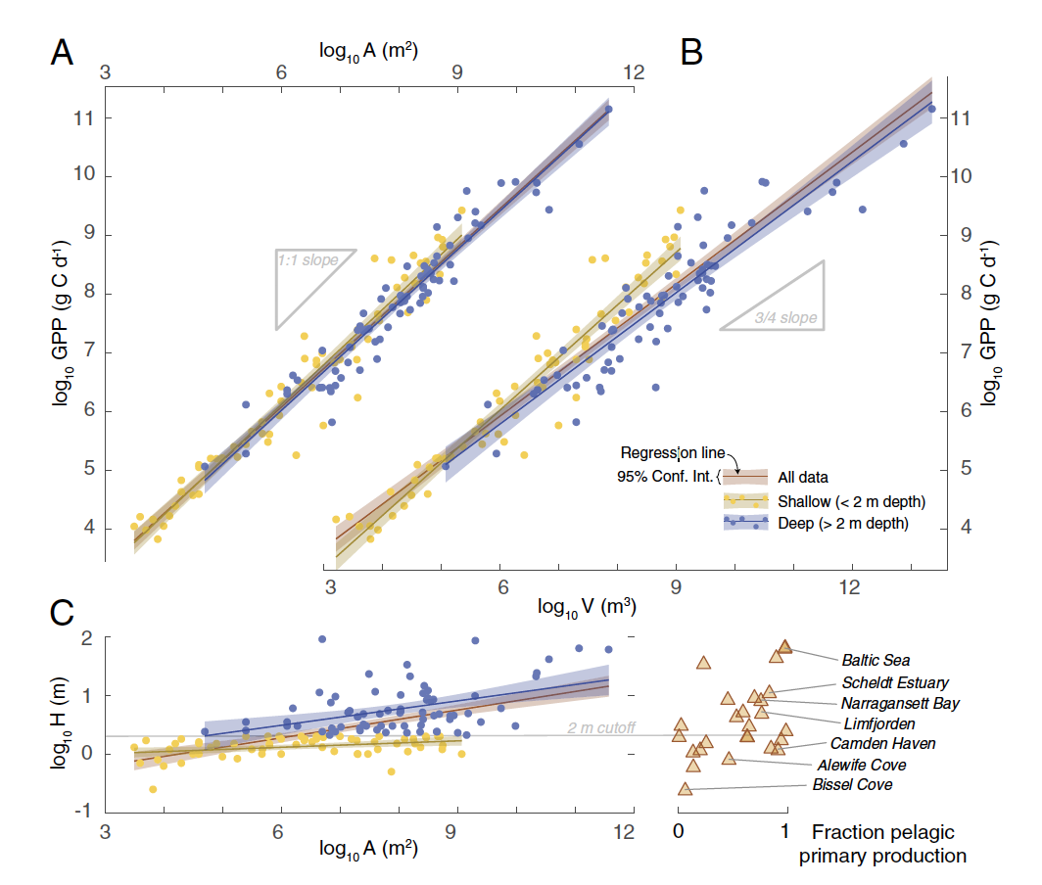
Contrast with organisms and individual ecosystems
MTE – sublinear scaling
0.66 or 0.75 (Brown, West, etc)
Estuaries and Lakes
Nidzieko, Glazier, Schramski
Shallow – linear
Deep – sublinear (0.75)
River Networks
Based on watershed size – linear to superlinear
Based on benthic area –sublinear to linear (similar to individual estuaries or lakes)
Varies with flow, depends on reaction rate.
Nidziko 2017

Slide 38
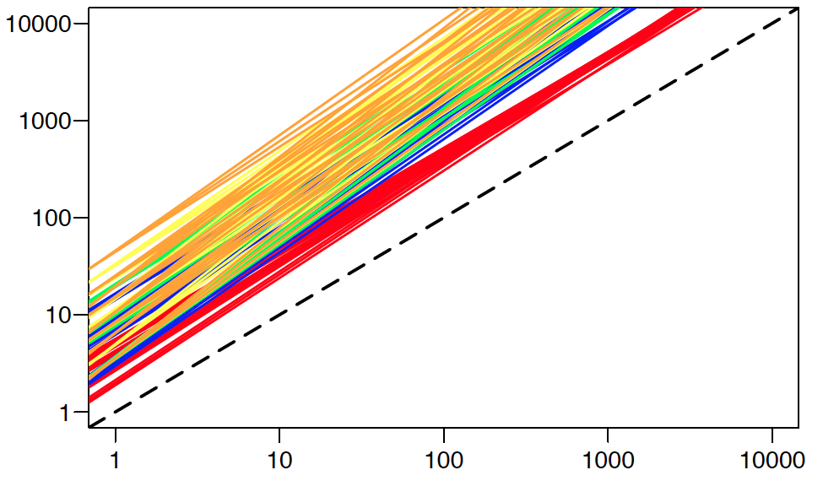
First-order Processing (Denitrification) variability of flow
High Runoff = 2500 mm/yr
Power Slope ->
1.07 – 1.33
Cumulative Process (Mass/T)
Low Runoff = 50 mm/yr
Power Slopes ->
0.98 – 1.12
Low flow has linear scaling
Approaches cumulative length scaling
High flow shifts to super-linear scaling
Approaches cumulative benthic area scaling
Drainage Area (km2)
Notes:
At low flow, slopes are nearly linear (approaching length scaling)
At high flow, slopes are superlinear (near BSA scaling

